Slide 1
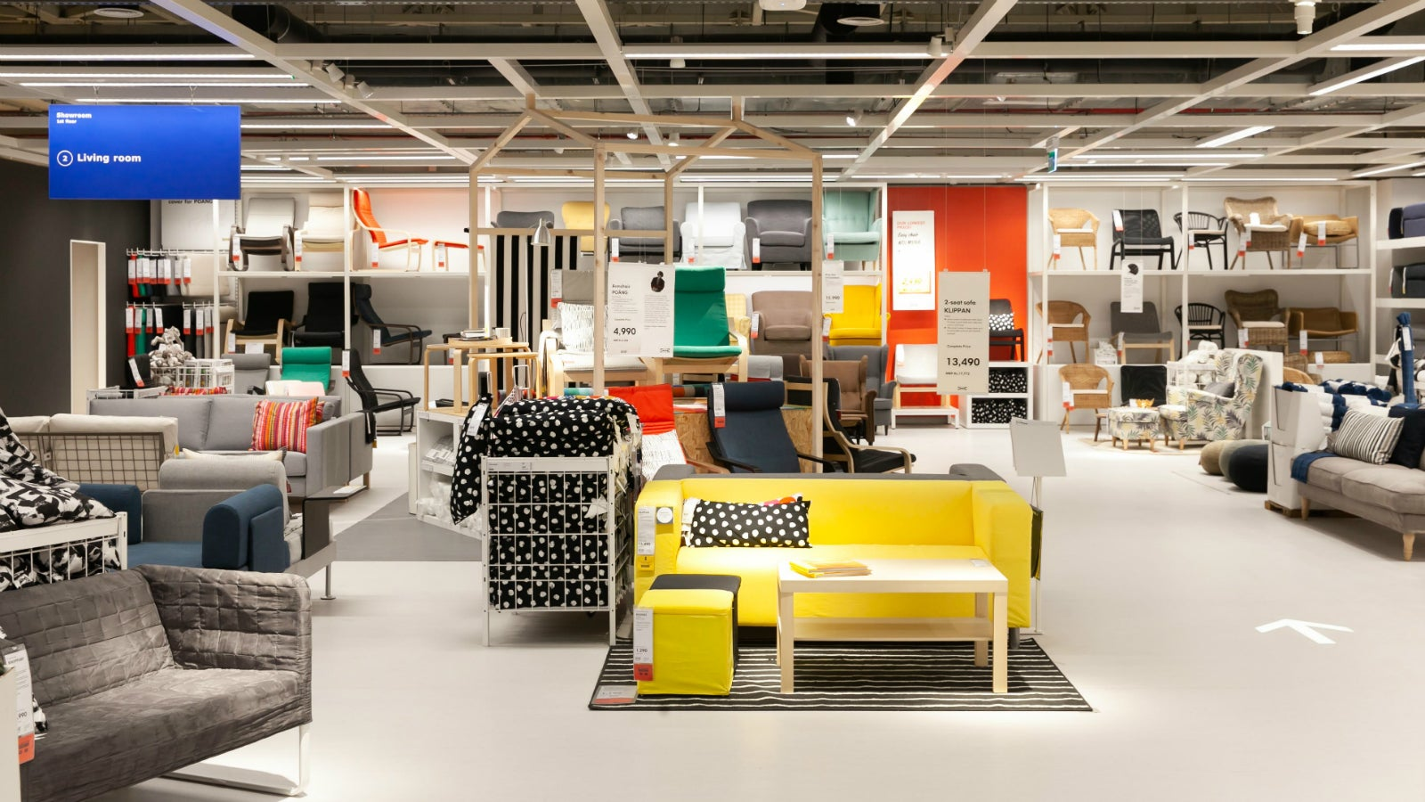

Slide 2


Slide 3
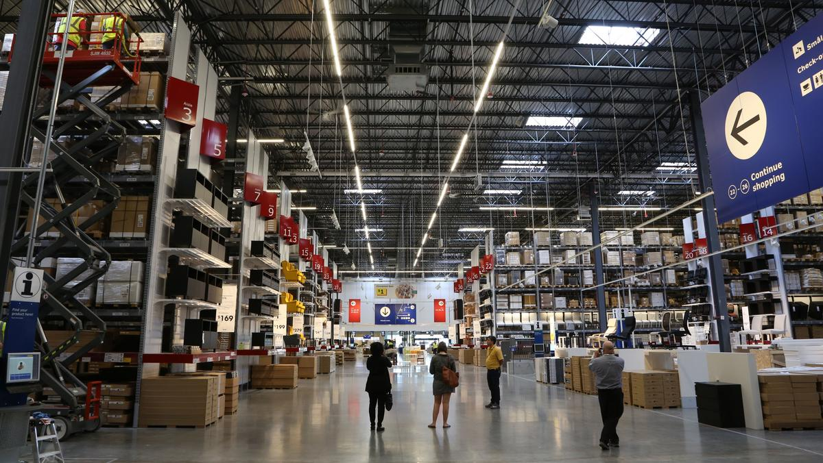

Retail Store Sales: Top 5 Items by Total Money Spent
This analysis highlights the items that account for the largest expenditures in our retail store operations, derived from Total Spent = Item Price x Quantity.
Overview of Key Sales Metrics:
Unique Sales: 12,580 unique transactions/purchases
Median of Price per unit: $23.00
Quantity sum: 66,880 units purchased in total
Total Spent: $2,000,000
Top Items:
Item_25_FHE (Industrial Grade Water Filter)
Item_25_BUT (Premium Aged Beef Cut)
Item_25
_FOOD (Gourmet Imported Cheese Wheel)
Item_24_FUR (Luxury Dining Table Set)
Item_23_BUT (Artisan Sausages Bulk Pack)

Slide 4
Top Items:
Item_25_FHE (Industrial Grade Water Filter)
Item_25_BUT (Premium Aged Beef Cut)
Item_25
_FOOD (Gourmet Imported Cheese Wheel)
Item_24_FUR (Luxury Dining Table Set)
Item_23_BUT (Artisan Sausages Bulk Pack)

Slide 5
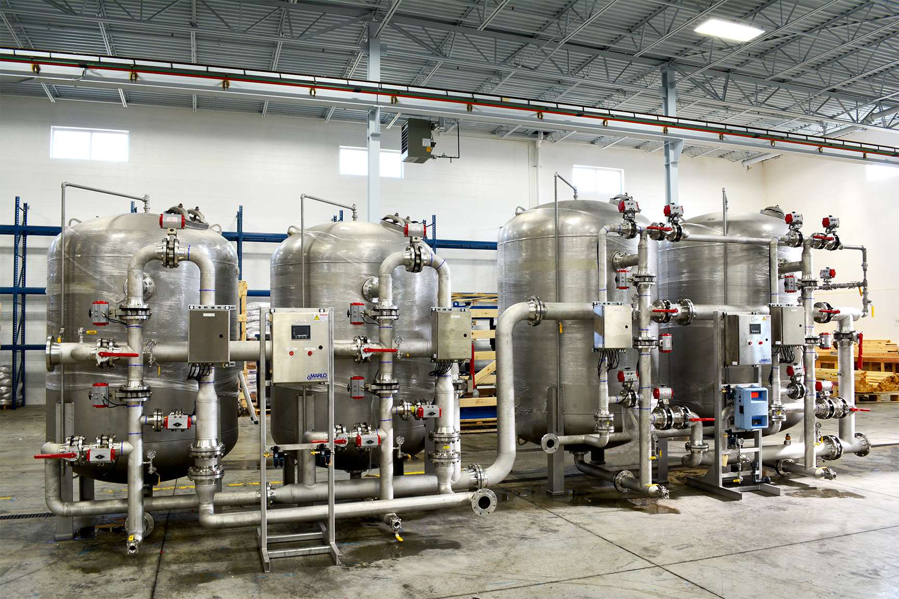
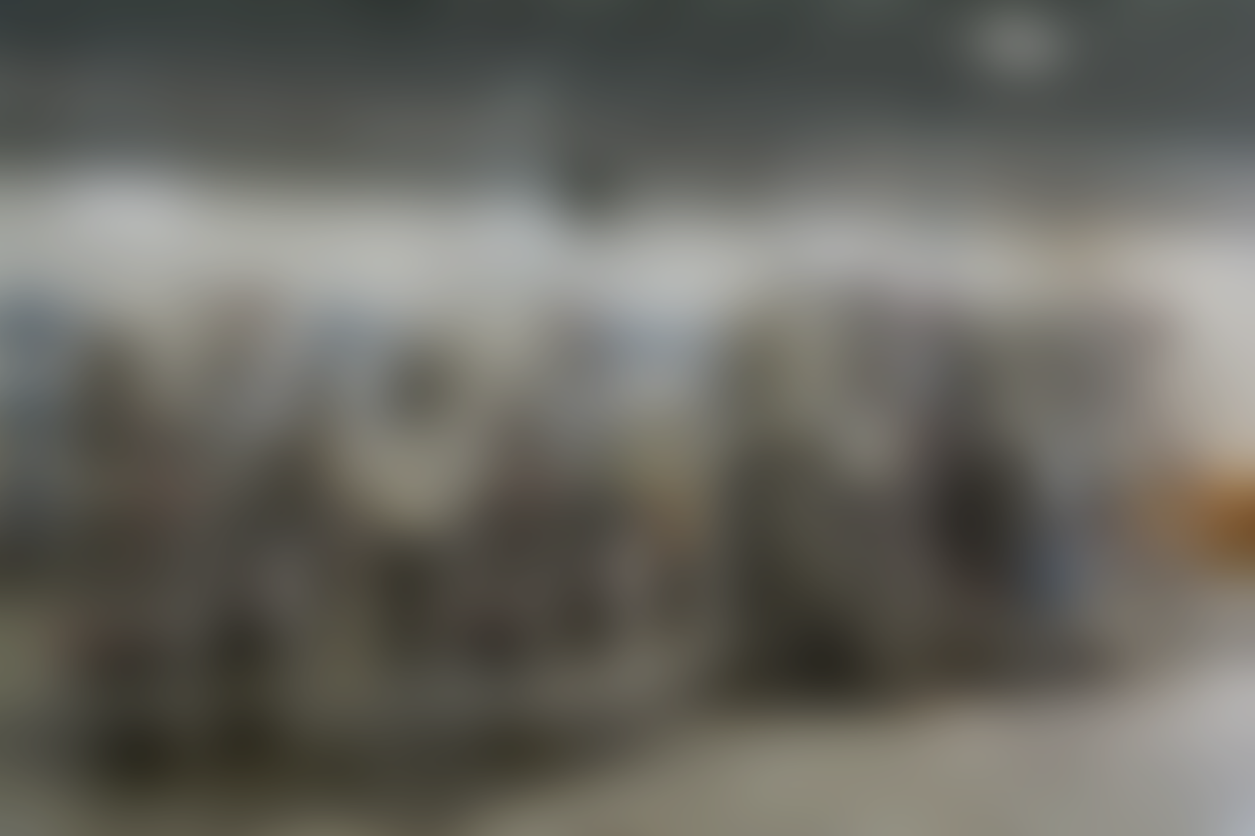
Top 1: Item_25_FHE
(Industrial Grade Water Filter)
Category: Electric household essentials
Observation: This item, likely a high-end or large-capacity filter used for commercial purposes or specific equipment, accounts for the highest total expenditure. Its significant cost suggests it's either a premium component or a frequently replaced necessity within its category. Given its "FHE" (Electric Household Essentials) category and top expenditure, it's plausible it's an industrial-grade or specialized filter rather than a typical consumer one, justifying a higher individual price.

Slide 6
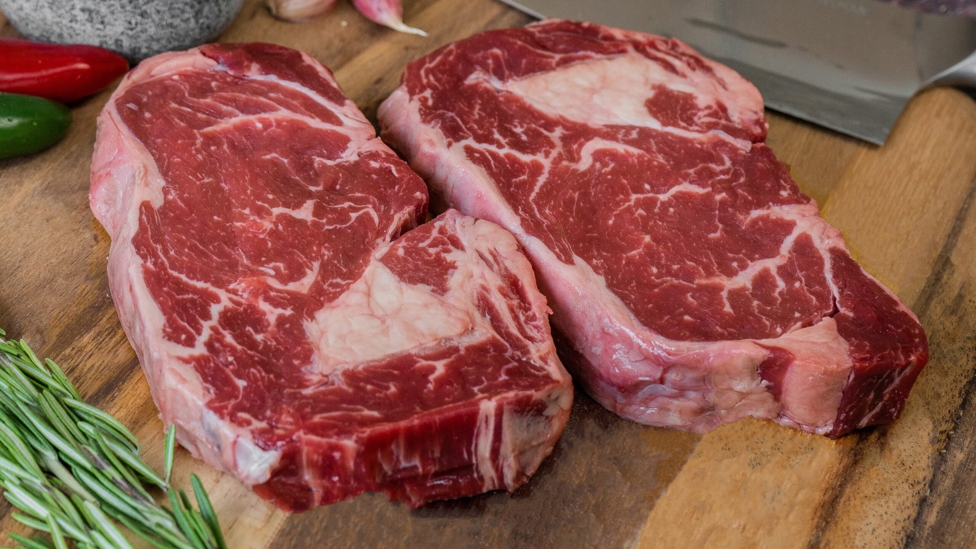

Slide 7
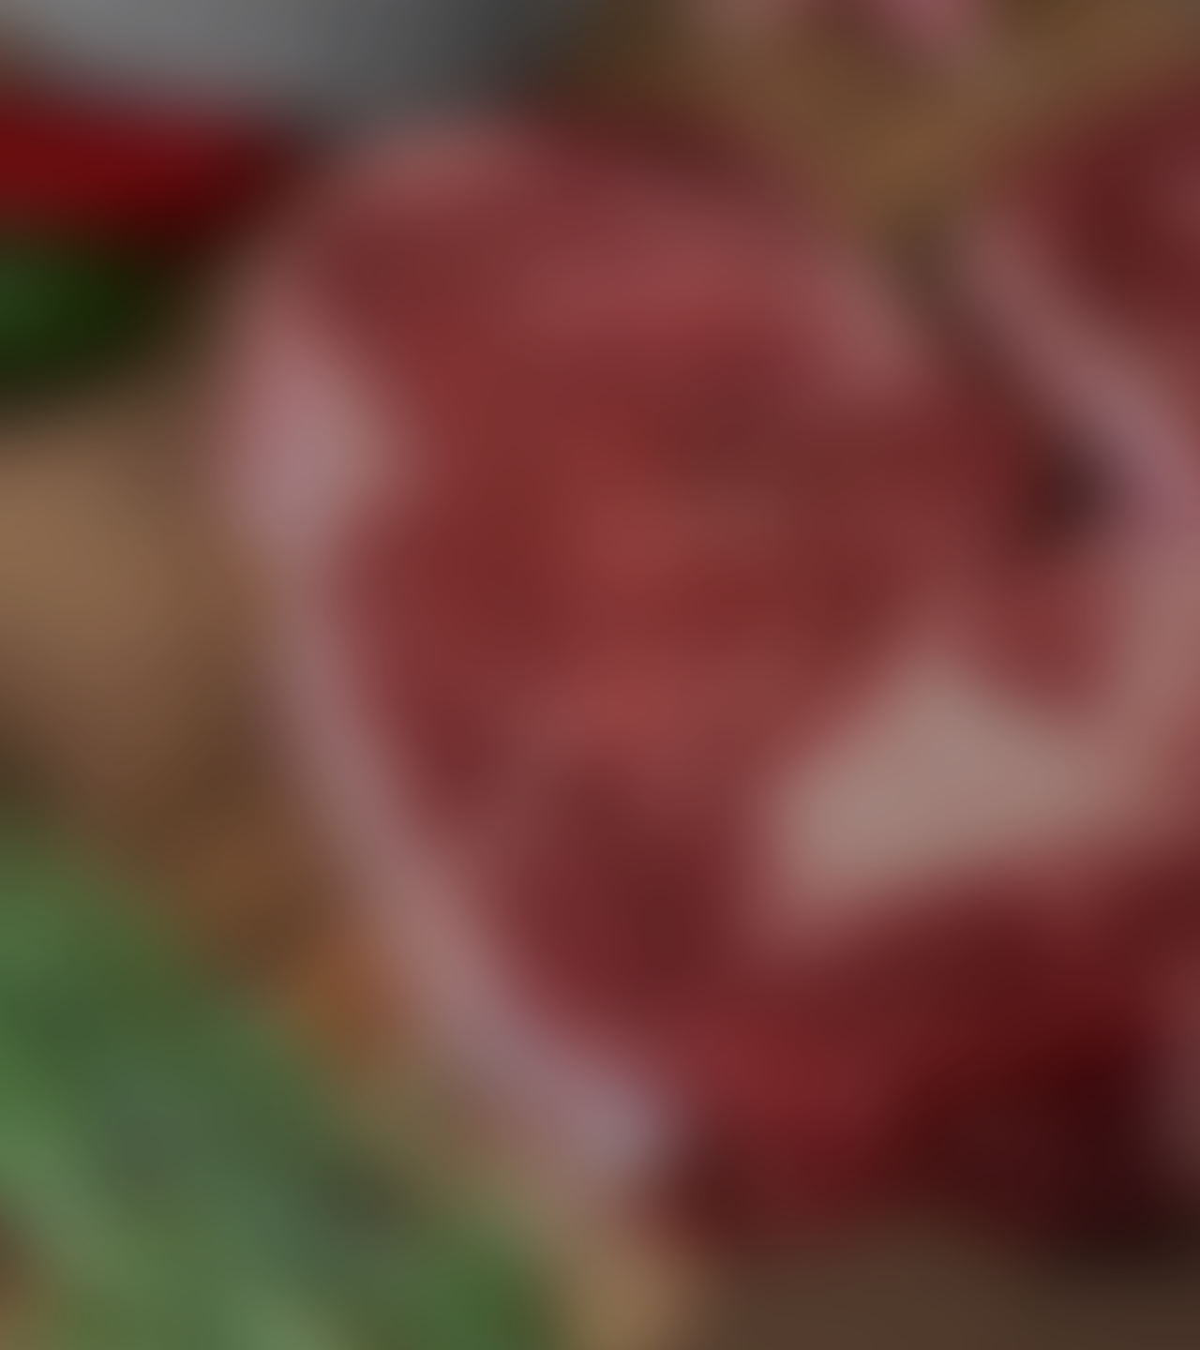
Top 2: Item_25_BUT
Premium Aged Beef Cut
Category: Butchers
Observation: As a "Butchers" item with a high expenditure, this suggests a premium meat product, such as a large cut of aged beef or a specialty meat, purchased in substantial quantities or at a high unit price. Its position as the second highest spent item underlines its importance to operations, likely catering to high-value menu items or specific culinary needs.

Slide 8
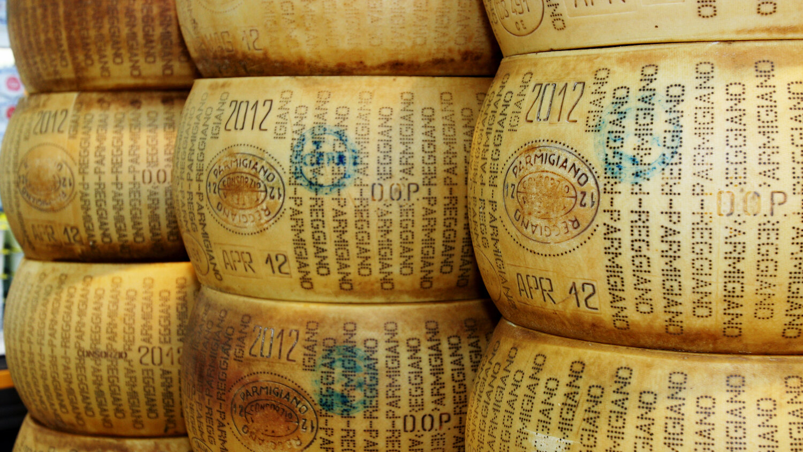

Slide 9

Top 3: Item_25_FOOD
Gourmet Imported Cheese Wheel
Category: Food
Observation: Falling under the broad "Food" category and ranking third in total spent, this item likely represents a high-value gourmet product, such as a whole wheel of imported cheese, high-quality olive oil, or a specialty ingredient. Its high expenditure points to either a very high unit price or consistent, large-volume purchasing for diverse culinary applications.

Slide 10
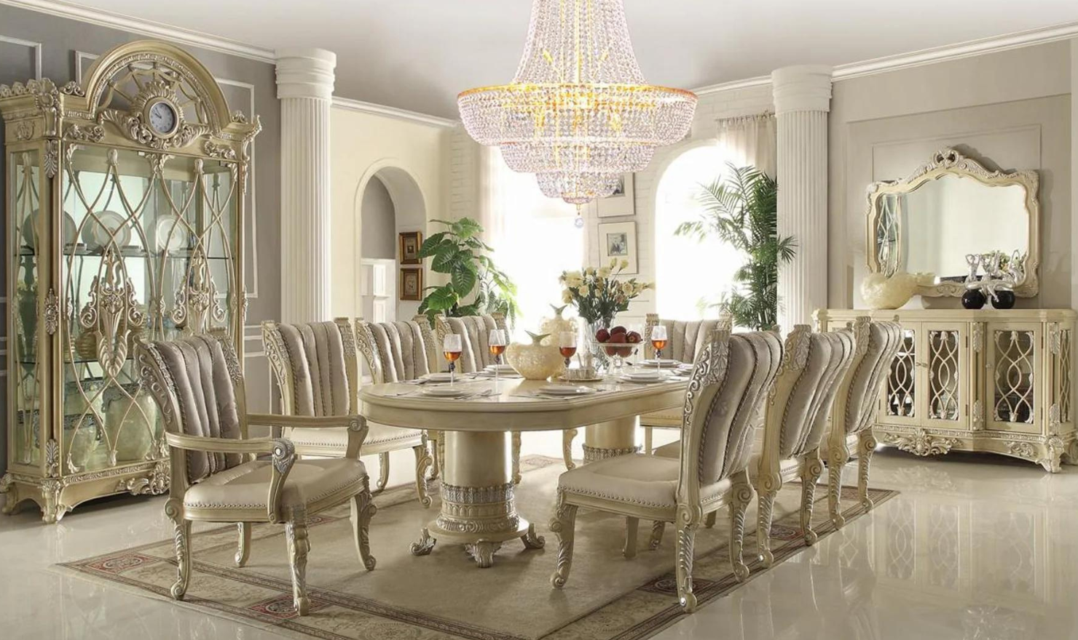

Slide 11

Top 4: Item_24_FUR
Luxury Dining Table Set
Category: Furniture
Observation: This "Furniture" item, being a top expenditure, strongly indicates a high-value furniture piece, such as a luxury dining table set or a commercial-grade seating arrangement. Furniture typically involves less frequent but high-cost purchases, and this item's ranking suggests a significant investment in store or restaurant aesthetics/functionality.

Slide 12
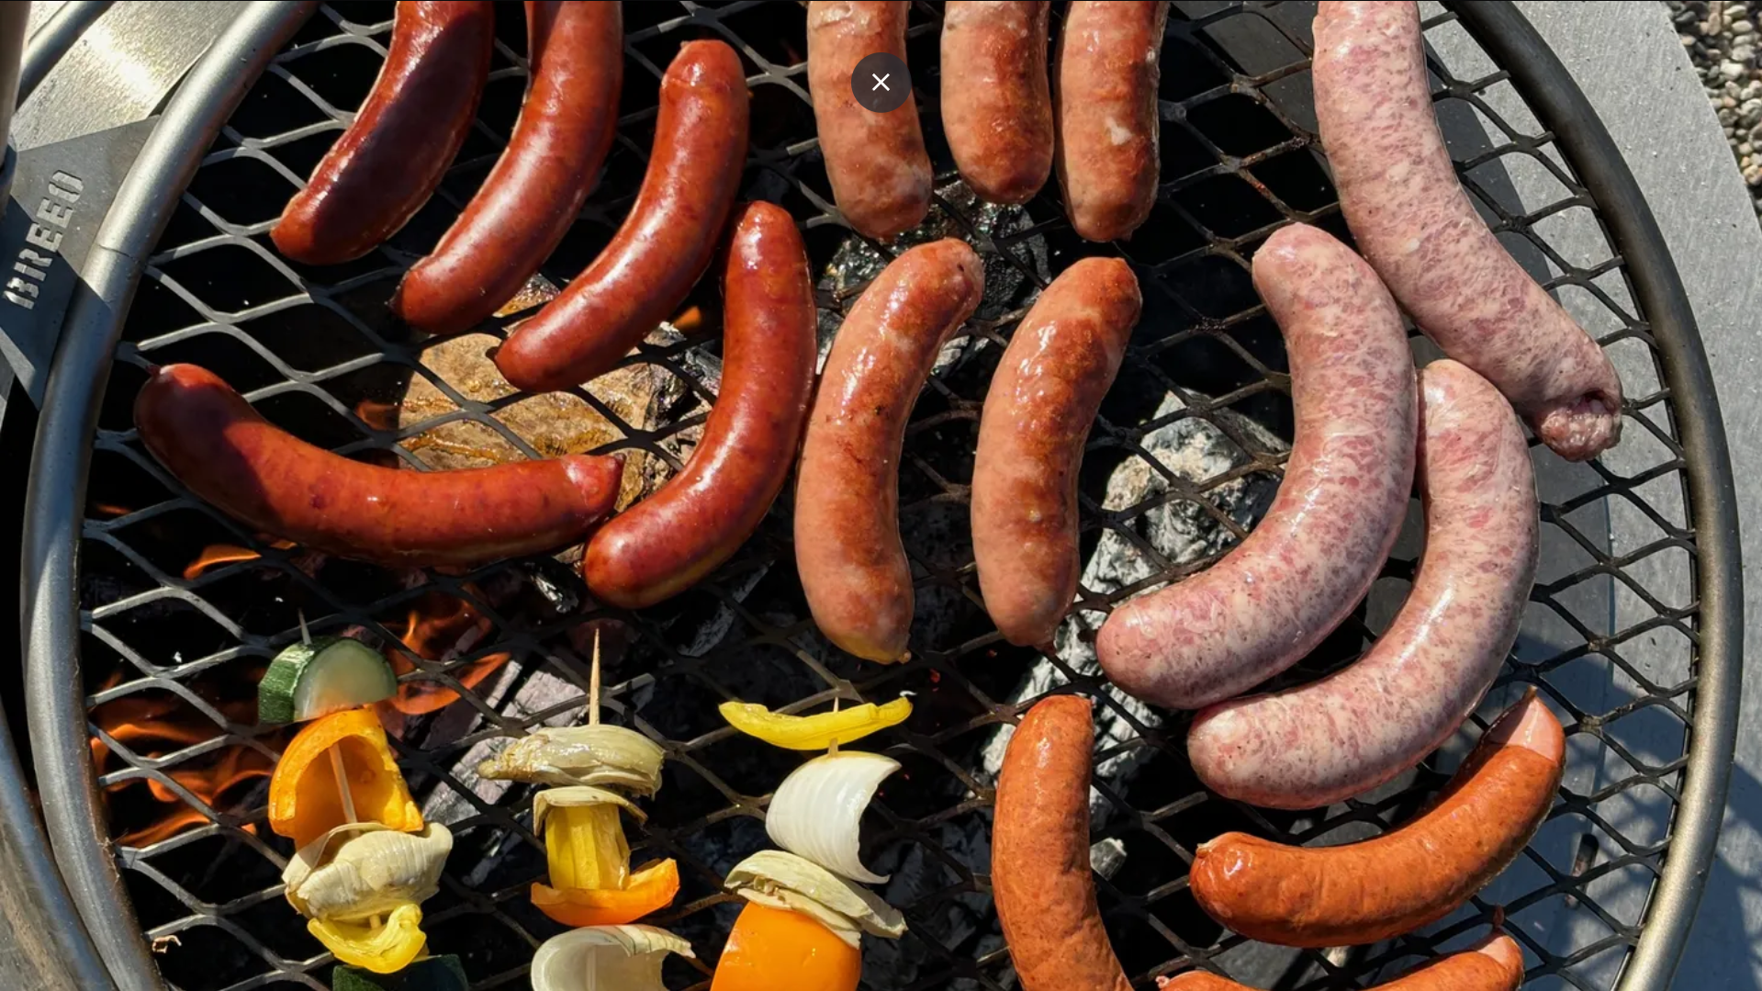

Slide 13

Top 5: Item_23_BUT (Artisan Sausages Bulk Pack)
Category: Butchers
Observation: Another "Butchers" item making it to the top 5, this likely represents a specialty or artisan meat product, such as a large bulk order of gourmet sausages or a specific cut of poultry. Its high expenditure, while slightly less than the "Premium Aged Beef Cut," suggests consistent demand or a high unit cost for a more specialized offering within the butcher's category.

Slide 14
